Slide 1

Group 18
Facebook performance Metrics prediction
Mirjam Nilsson​

Slide 2
Team MEMBER
1
2
3
4
Adepoju Jeremy
Alawode Abiodun
Joy David
Martha Olorunfemi
5
6
7
Olamide Durodola
Osei Asibe
Tunde Shaba

Slide 3
introduction
The Media
Social Media has seen exponential growth in its users, especially with the exchange of feedback and ideas on products and services.
The metrics
THE MACHINE LEARNING
Facebook metrics have been adopted as a key performance index for tracking every business, industry, and corporation on success.
Machine Learning plays a crucial role in tracking this development effectively.

Slide 4
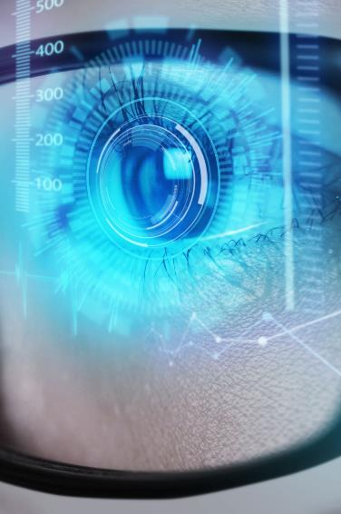
Aims and objectives
To determine if Facebook metrics prediction can be adopted to increase brand engagement for industries, businesses, and corporations using machine learning.

Slide 5
Statement of PURPOSE.
This study demonstrates the application of machine learning to forecast Facebook performance metrics using test data. However, the project “Facebook Performance Metrics Prediction” demonstrates how to predict a data set using machine learning to determine what category of posts on a Facebook page would have the highest metrics.
Our technology will also identify the Post, Message Category with both negatives and positives as possible. When opting to connect through social media and adapt the promotion of goods and services, a system that can foresee the effects of specific published posts can be a significant asset.
Advertising managers might evaluate the reception of the posted content and align strategies to maximize its impact while profiting from the forecasts made.

Slide 6
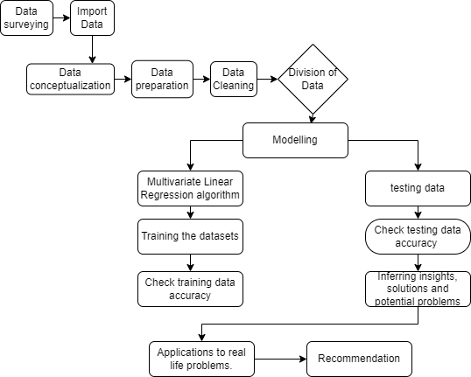
Methodology

Slide 7

Data source
​
Our data were obtained from the UCI repository. A Center for Machine Learning and Intelligent Systems.

Slide 8
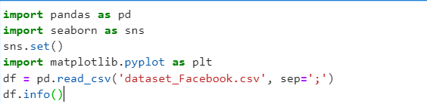

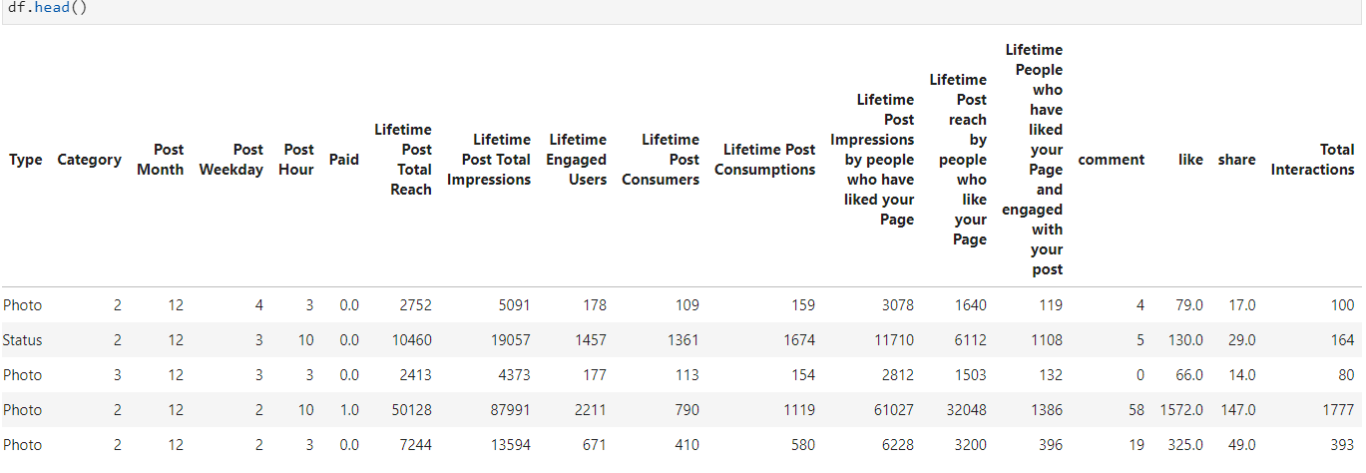
Exploratory data Analysis.
There are 19 columns, but columns from 7 to 14 are recorded after posting.
Few null values in the columns `paid, like, and share, which we cleaned up.
`Type` column has four types, and the photo is the most frequent.

Slide 9
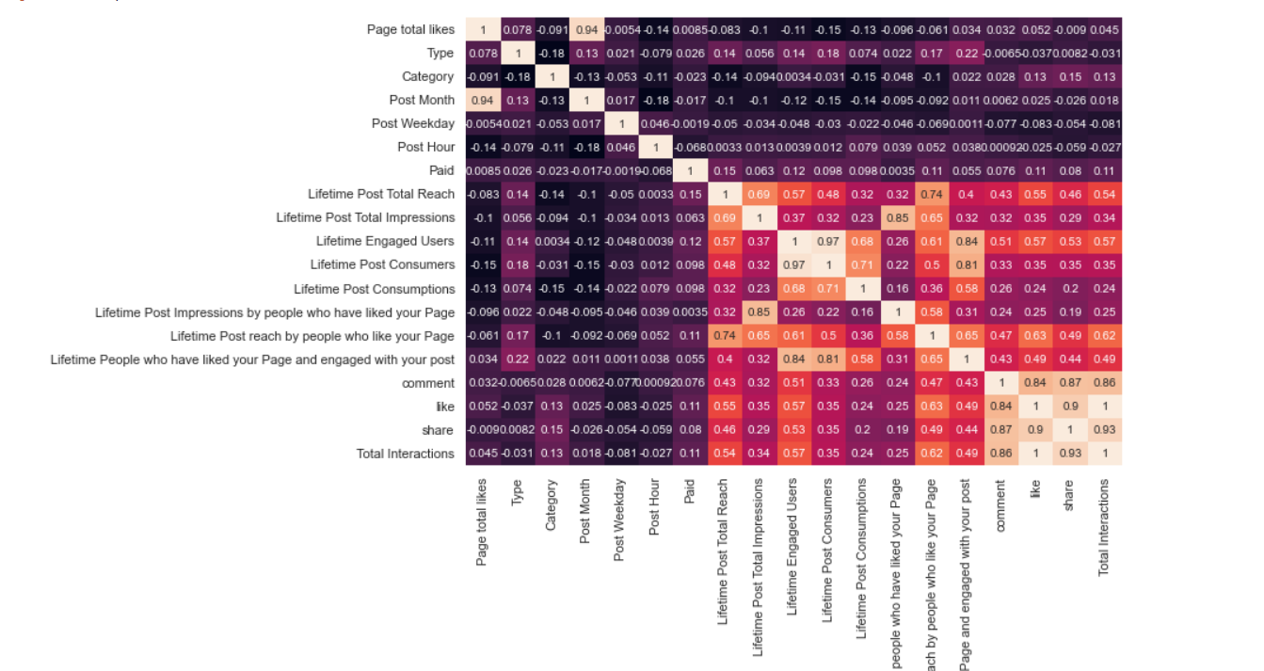
Correlation among columns
Using Heat map

Slide 10
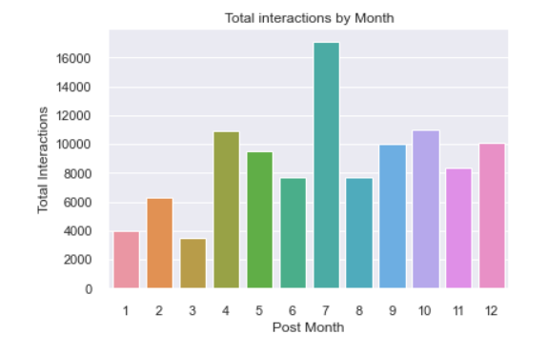
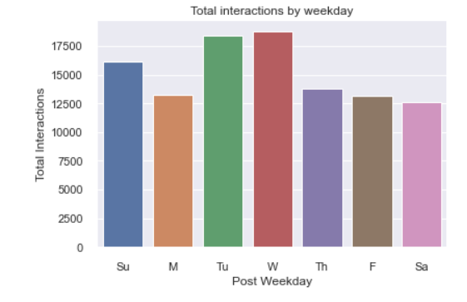
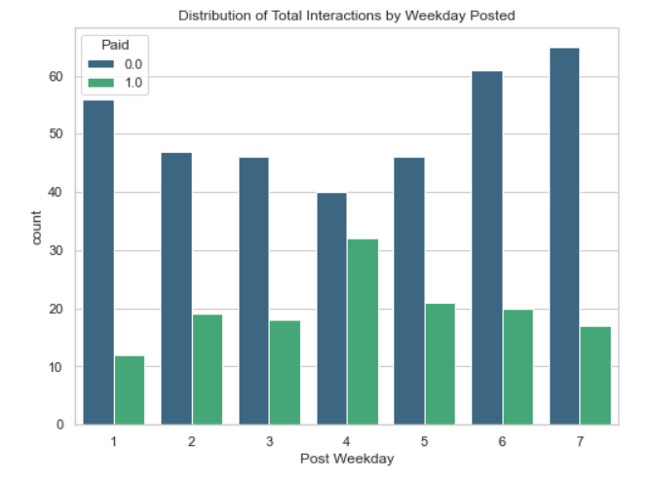
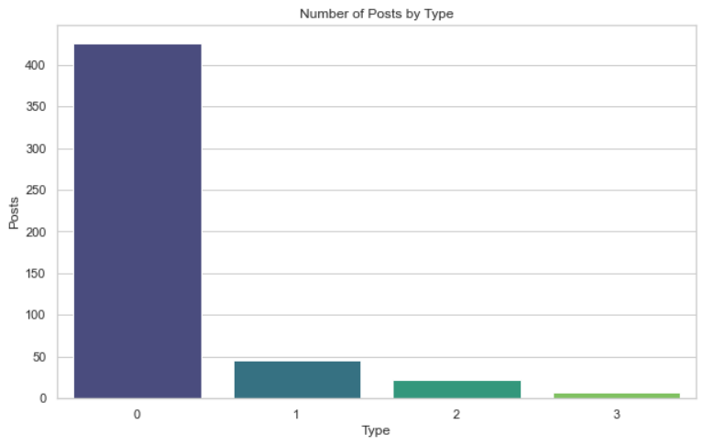
The weekday doesn't affect the interactions
The paid posts get more interactions than nonpaid
A slight positive trend between the paid posts and the page likes.
No considerable trend between non-paid and page likes

Slide 11
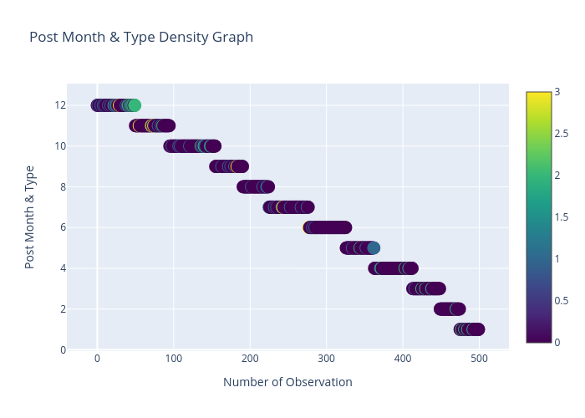
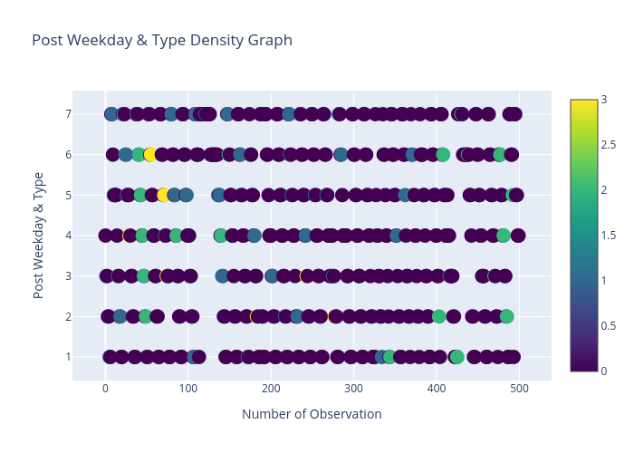
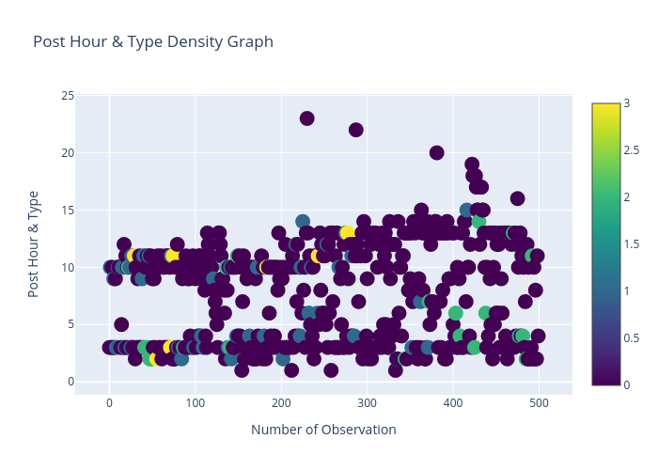
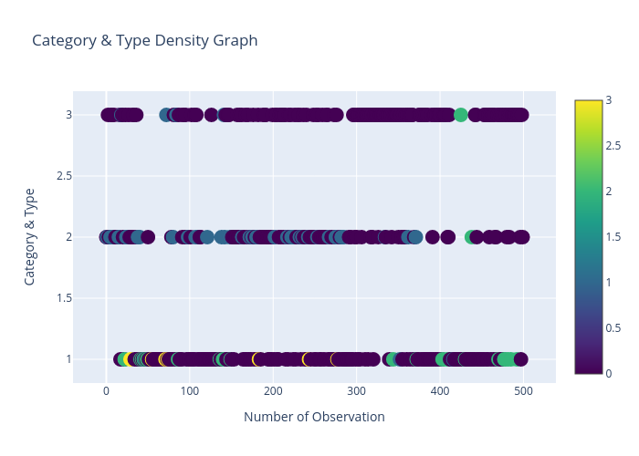
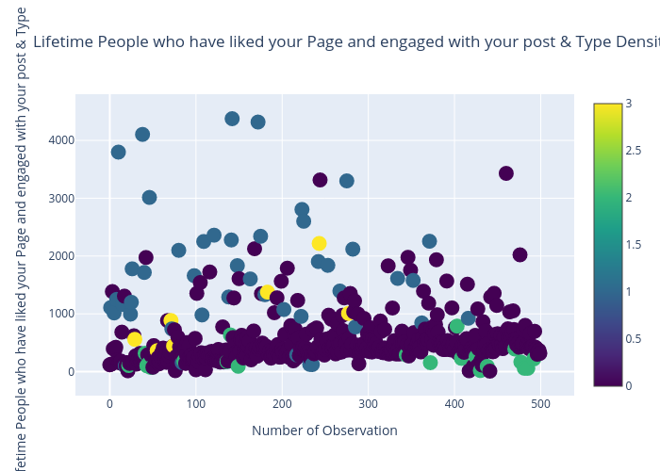
Visualization of Non-relationship between the feature and the target using a density graph

Slide 12
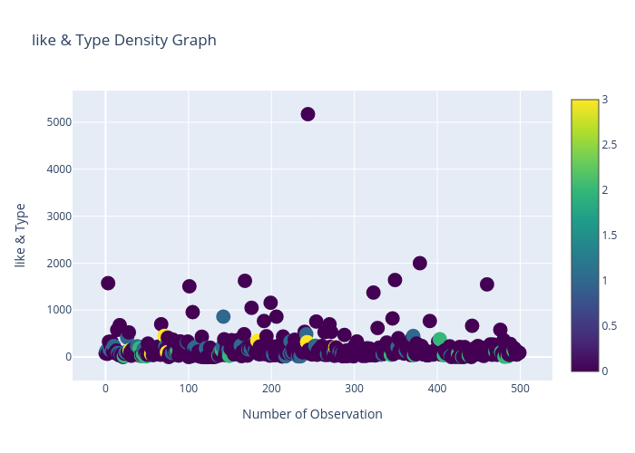
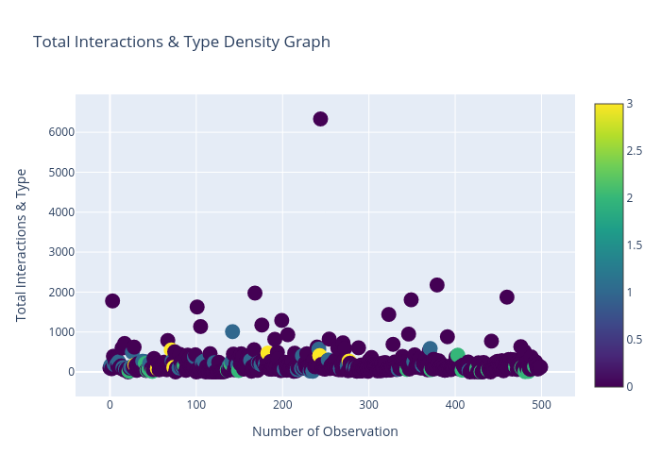
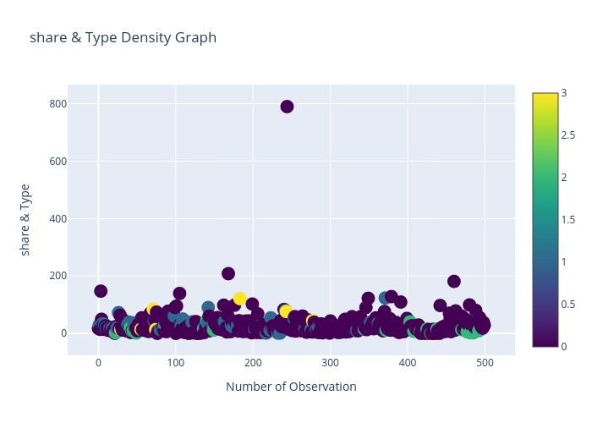
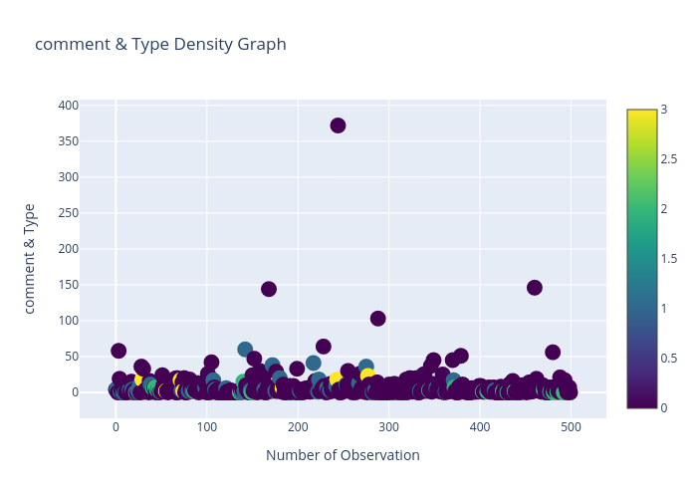
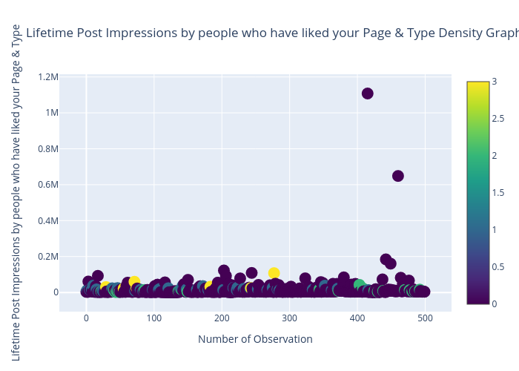
Visualization of the relationship between the feature and the target using a density graph

Slide 13

MACHINE LEARNING IMPLEMENTATION.

Slide 14
Machine learning libraries
Pandas
MATPLOTLIB
NUMPY
JOBLIB
PLOTLY
SCIPY
CHART-STUDIO
LIGHT-GBM
HYPEROPT
SCIKIT-LEARN

Slide 15
Machine learning algorithms.
Multinomial logistic regression((M.L.R)
Random forest
xg-boost
CAT-BOOST
Accuracy
accuracy
accuracy
Accuracy
StatModel: 0.84
Scikit-learn: 0.86
Scikit-learn:0.808
Scikit-learn:0.80
Scikit-learn:0.81
Best-test:235

Slide 16
Machine learning algorithms.
LIGHT-GBM BOOST
Gaussian naïve bayes
K-Nearest neigbour
DECISION TREES
ACCURACY
ACCURACY
ACCURACY
ACCURACY
Scikit-Learn: 0.77
Scikit-Learn: 0.838
Scikit-Learn:0.84
Scikit-Learn: 0.85

Slide 17
DISCUSSIONS
Overall, the models gave an accuracy > 0.80, with the LightGBM algorithm giving a testing accuracy of 0.25.
Also, we determined the speed of the models, the confusion matrix, to check for false positives and negatives.
We also used decision trees to make our results further explainable.

Slide 18
CRITIQUE 1
The training data was too small, so we noticed overfitting when plotting the confusion matrix, as certain classes were not predicted.
There was no generalization of the data.
In lieu of this, we had to increase the complexity of our model using other algorithms, especially gradient-boosting algorithms.
Why? They work best for categorical data.
​

Slide 19
CRITIQUE 2
Using Cat Boost: We increased the number of training epochs, which further helped in understanding the data better, it provided a perfect accuracy.
The time used for the computation of Cat Boost was very fast.
​

Slide 20
CRITIQUE 3
Due to overfitting, we had to simplify the training data, which we did, and simplify the model; cross-validation was used to check the accuracy of each model.
But overall, we needed more data to get a more accurate prediction and training accuracy.
​

Slide 21
CONCLUSION
Using, 8 different algorithms, which are the Multinomial Logistic Regression(M.L.R), Random Forest, XG-boost, Cat boost, LightGBM Boost, K Nearest Neighbor(Knn), and Decision trees.
It was deduced that some model out-performed others in terms of speed of accuracy, time, accuracy values and cross-validation scores.
Also, we concluded that LightGBM was the fastest algorithms, out of all we used in modelling, and Cat Boost, was the best algorithm for multi-class data, because we never needed to encode, and it trains the data, and gives out the training accuracy of the best trained dataset.

Slide 22

Thank you
​DLYA DATA SCIENCE BOOTCAMP 3.

